Slide 1
Sorting

Slide 2
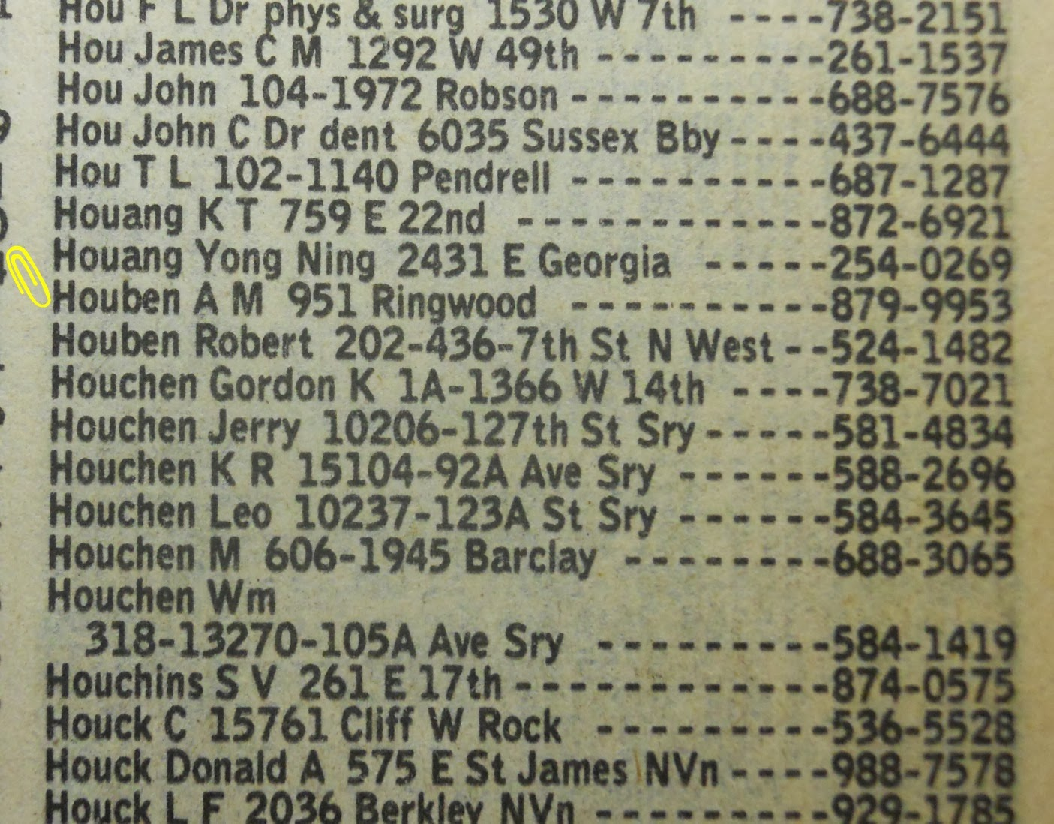
Sorting
Sorting refers to arranging a set of data in some logical order.
Example: Telephone directory having name, address, and phone number.
Example: 1, 2, 3, 4, 5, 6, 7, 8, 9

Slide 3

Why to Sort?
Searching an element is faster.
Binary search $\log_{2}{n}$ vs Linear search n.
Rank Queries: find the kth largest/smallest value.
1 2 3 4 5 6 7 8 9

Slide 4
If array is sorted!
It is difficult to insert an element while preserving the sorted structure.
40 50 55 60 70 75 80 85 90 92
Insert 65
Similarly, it is difficult to delete an element while preserving the sorted structure.
40 50 55 60 70 75 80 85 90 92
Delete 70

Slide 5
Sorting Algorithms
Selection Sort
Bubble Sort
Merge Sort
Quick Sort
What is the difference? Different techniques, different runtimes,....

Slide 6
Selection Sort
Consider the array: 6 4 9 1 6 2 0
You need to sort it in decreasing order: 9 6 6 4 2 1 0
Approach:
What is the location of largest element in the sorted array?
What is the location of second largest element in the sorted array?
As the name suggests, you need to select something.
Select the largest element in your array and swap it with the first element of the array.
Next, consider the subproblem of finding largest element in the array having n-1 elements, and so on.
Finally, a single element is already sorted.

Slide 7
Code
void selection_sort(int a[], int start, int end) {
if(start == end)
return;
int pos = findMax(a, start, end);
swap(a, pos, start);
selection_sort(a, start+1, end);
}
void swap(int a[], int i, int j) {
int temp = a[i];
a[i] = a[j];
a[j] = temp;
}

Slide 8
Bubble Sort
Consider the array: 5 3 1 9 8 2 4 7
You need to sort it in increasing order: 1 2 3 4 5 7 8 9
Approach:
Exchange consecutive values that are not in the correct order.
Observe the first iteration of the strategy.

Slide 9
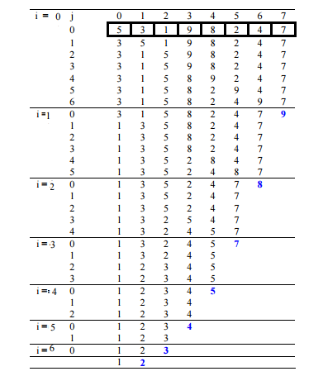
Example

Slide 10
Code
void swap(int *xp, int *yp)
{
int temp = *xp;
*xp = *yp;
*yp = temp;
}
// An optimized version of Bubble Sort
void bubbleSort(int arr[], int n)
{
int i, j, swapped;
for (i = 0; i < n-1; i++)
{
swapped = 0;
for (j = 0; j < n-i-1; j++)
{
if (arr[j] < arr[j+1])
{
swap(&arr[j], &arr[j+1]);
swapped = 1;
}
}
// IF no two elements were swapped by inner loop, then break
if (swapped == 0)
break;
}
}

Slide 11
Merge Sort
Merge sort consists of 3 parts.
Divide an array into two parts, A and B.
Sort array A and B independently (recursive call).
Merge A and B.
void merge_sort(int ar[], int start, int n) {
if (n>1) {
int half = n/2;
merge_sort(ar, start, half);
merge_sort(ar, start+half, n-half);
merge(ar, start, n);
}
}

Slide 12
Merging Two Sorted Arrays
Merge two sorted arrays A of size n and B of size m.
Create an empty array C of size n + m.
Variable i, j, and k
A
2
5
6
10
20
n=5
B
3
4
8
15
m=4
2 3 4 5 6 8 10 15 20

Slide 13
Merge Code
void merge(int ar[], int start, int n) {
int temp[50], k, i = start, j = start + n/2;
int lim_i = start + n/2, lim_j = start + n;
for(k = 0; k<n; k++) {
if((i < lim_i) && (j < lim_j)) {
if(ar[i] <= ar[j]) { temp[k] = ar[i]; i++;}
else { temp[k] = ar[j]; j++; }
}
else if(i == lim_i) {
temp[k] = ar[j]; j++;
}
else {
temp[k] = ar[i]; i++;
}
}
for (k=0; k<n; k++)
ar[start+k] = temp[k]; //in-place sorting
}

Slide 14
Quick Sort
Partition the array into two parts using a pivot, call it “a”.
One part contains all elements smaller than a
Other part contains all elements larger than a
Sort the partitions recursively
A pivot is any integer chosen to partition the array
It can be chosen randomly
It can be decided arbitrarily, say first element of the array

Slide 15
Partition function
Partition takes an array a[] of size n and a value called the pivot.
Pivot: is an element in the array, usually chosen as a[0].
Partition re-arranges the array elements into two parts:
the left part has all elements <= pivot
the right part has all elements >= pivot
Partition returns the index of the beginning of the right part.
11
31 4 10 35 59 31 3 25 35 11
Let Pivot be a[9] = 11

Slide 16
Steps
Let Pivot be a[0] = 31
a
11
0
31 4 10 35 59 31 3 25 35 11 0
0
31
10
L
pivot
R
As long as a[L] <= pivot, advance L by 1.
As long as a[R] >= pivot, decrease R by 1.
If L < R, exchange a[L] with a[R]. Advance L by 1; decrease R by 1.

Slide 17
Code
int partition (int arr[], int low, int high)
{
int pivot = arr[high]; // selecting last element as pivot
int i = (low - 1); // index of smaller element
for (int j = low; j <= high- 1; j++)
{
// If the current element is smaller than or equal to pivot
if (arr[j] <= pivot)
{
i++; // increment index of smaller element
swap(&arr[i], &arr[j]);
}
}
swap(&arr[i + 1], &arr[high]);
return (i + 1);
}

Slide 18
Quick Sort
void quicksort(int a[], int p, int r)
{
if(p < r)
{
int q;
q = partition(a, p, r);
quicksort(a, p, q-1);
quicksort(a, q+1, r);
}
}

